Slide 1
Models & Injection

Slide 2
why do we want models?

Slide 3
Need of models
Handles raw JSON objects.
Extensibility .
Don’t need to define type everything as <Any>.
Basic model
import {Car} from "./car.model";
export class User {
id: number;
name: string;
car: Car;
}

Slide 4
Example :
User model:
export class User {
firstname : string;
lastname : string;
}
Html template:
<ul>
<li *ngFor="let user of users">
{{ user.firstName }} {{ user.lastName }}
</li>
</ul>

Slide 5
getFullName() {
return this.firstName + ' ' + this.lastName;
}
we can now simply call this function in our template:
<ul>
<li *ngFor="let user of users">
{{ user.getFullName() }}
</li>
</ul>

Slide 6
Dependency injection

Slide 7
Why we Need Dependency injection?

Slide 8
Dependency injection (DI)
Application design pattern.
Used to increase efficiency and modularity.
framework provides declared dependencies

Slide 9
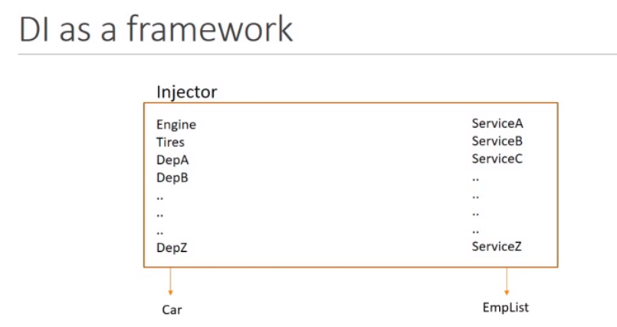
Example:

Slide 10
What we learnt
Need of models
How can we use models in our project
Concept of dependency injection
Dependency injection as angular framework

